Slide 1
DJANGO PROJECT
HOSTEL MANAGEMENT SYSETM

Slide 2
DESCRIPTION
The Hostel Management System is a django based website to provide college students accommodation to the university hostel more efficiently. This project also keeps details of the hostellers. It is headed by Warden.
This document is intended to minimize human works and make hostel allocation is an easier job for students and hostel authorities by providing online application for hostel, complaint registration, leave applications etc. Warden will get complaints and leave applications from students .

Slide 3
OBJECTIVES
Maintaining students as hostellers.
Each student is alloted with a room.
Students can register complaints and write leave applications.
Admin can get complaints and leave applications from students

Slide 4
LINK FOR WEBSITE
Python anywhere link :
https://prajwalrp.pythonanywhere.com/

Slide 5
CONTRIBUTION
SANATHKUMAR G : Took the initiative and started the project by collecting all the necessary information. Coded views.py, fetching data from the database and displaying it in admin page after logging in, in tabular form and static CSS for the project, templates.
CHETAN B CHAVHANNAVAR : Validating student and admin login forms, forms.py, validating valid credentials for student login and admin login, coded some views.py part and templates.
PRAJWAL POTHALKAR : Created the Student Registration model, Leave Applications and Complaints, coded in models.py, urls.py and admin.py, static CSS for the project, templates and hosted the app live on pythonanywhere.

Slide 6
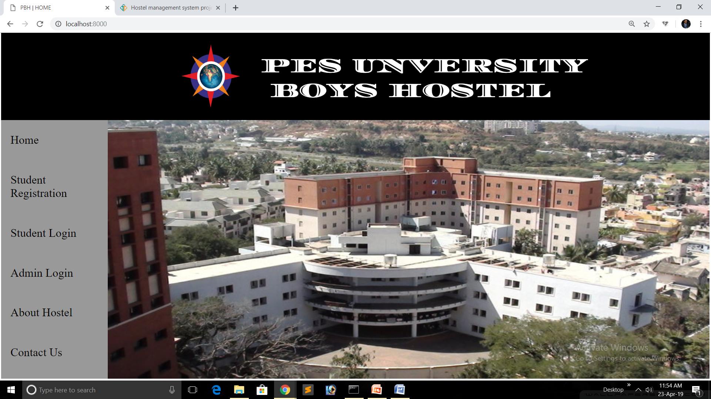

Slide 7
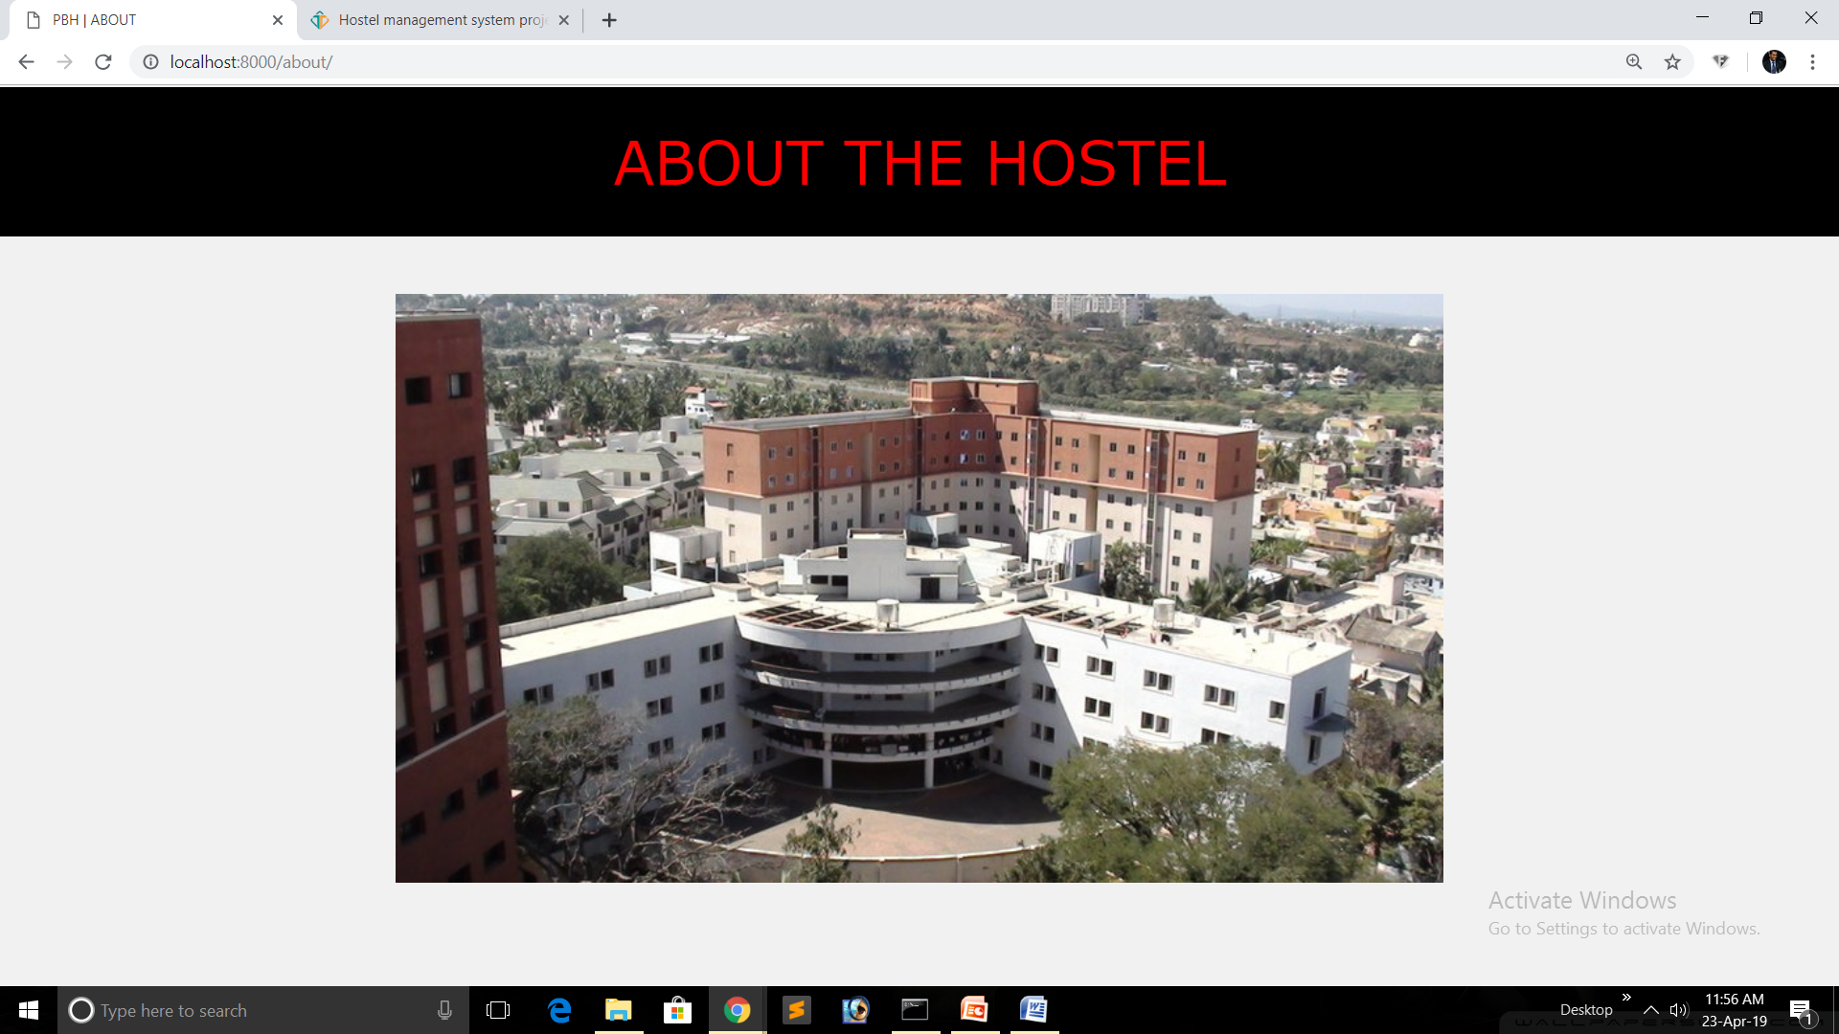

Slide 8
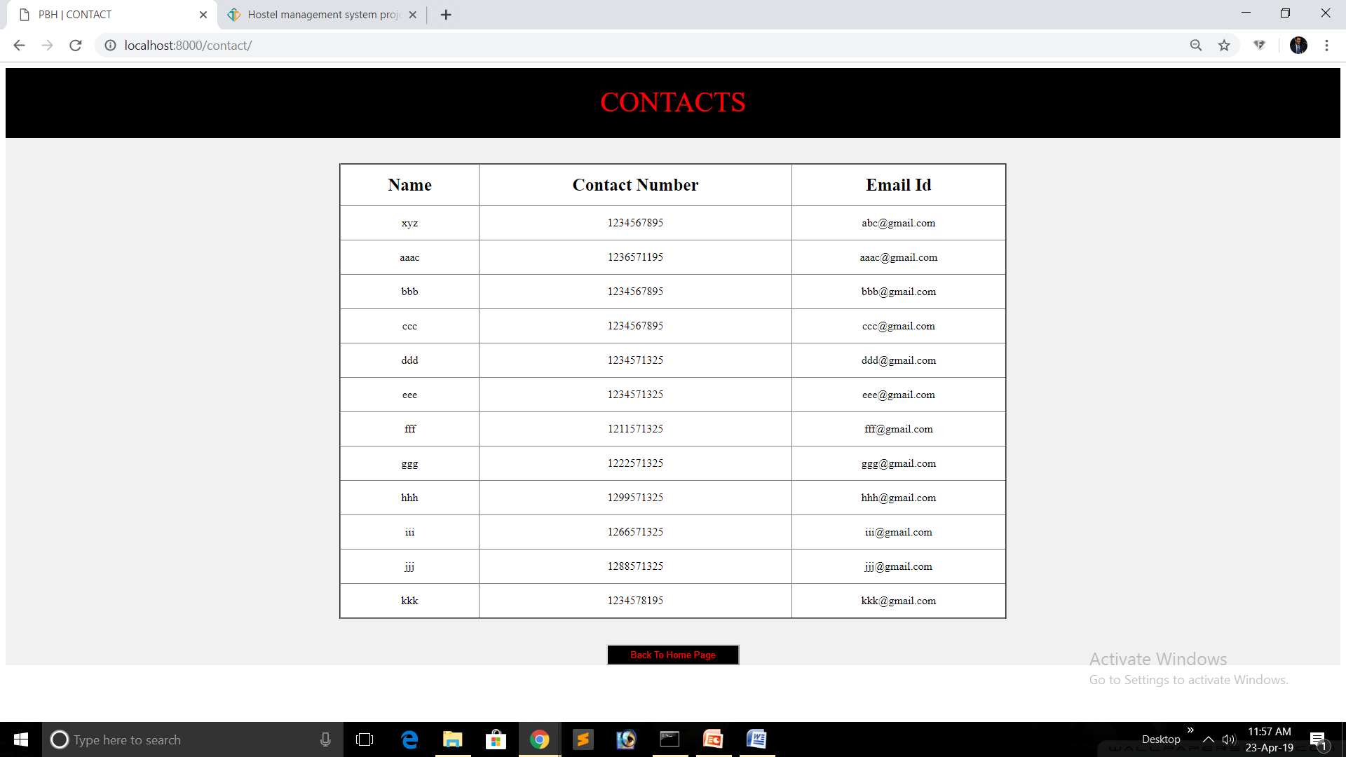

Slide 9
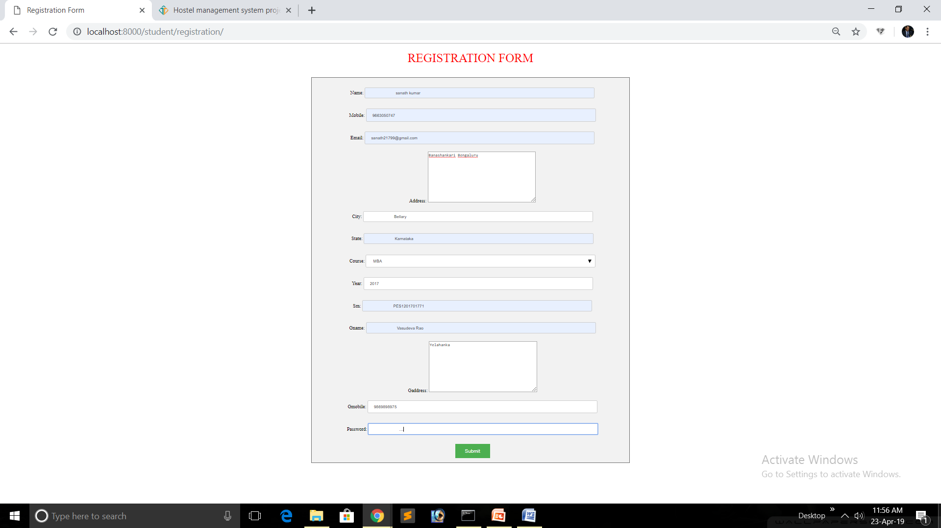

Slide 10
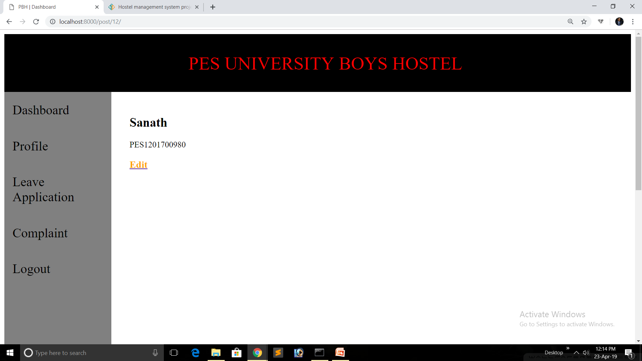

Slide 11
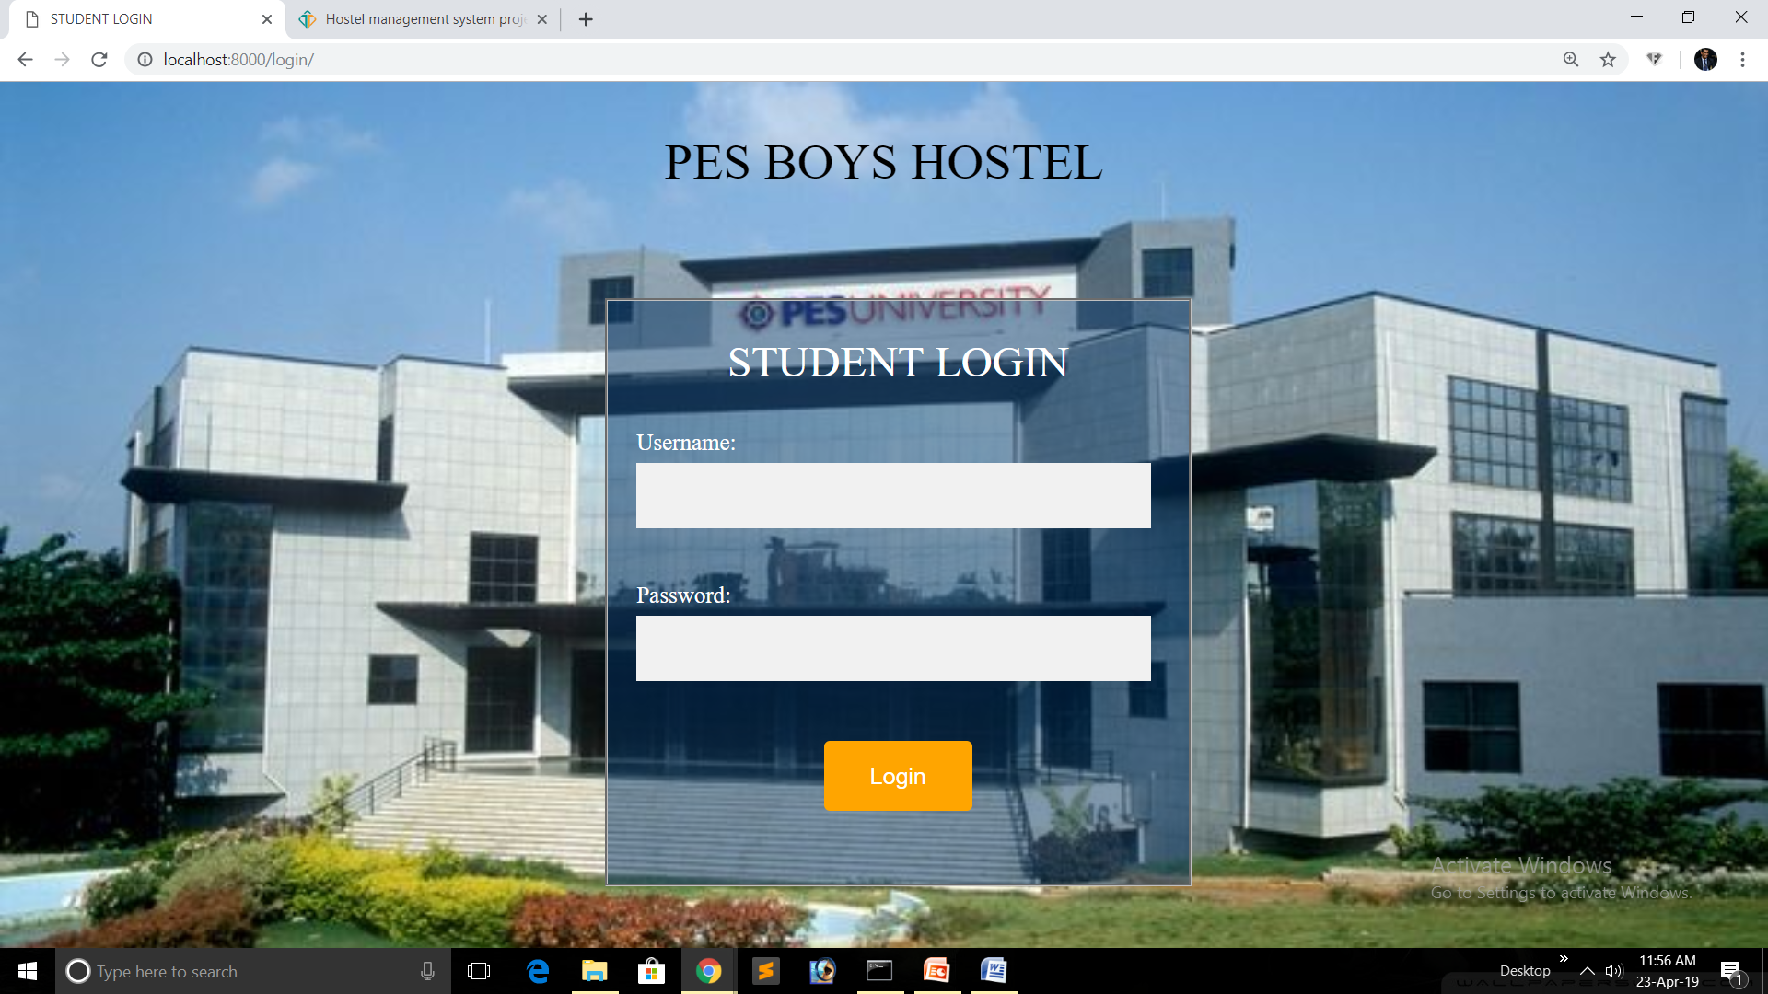

Slide 12
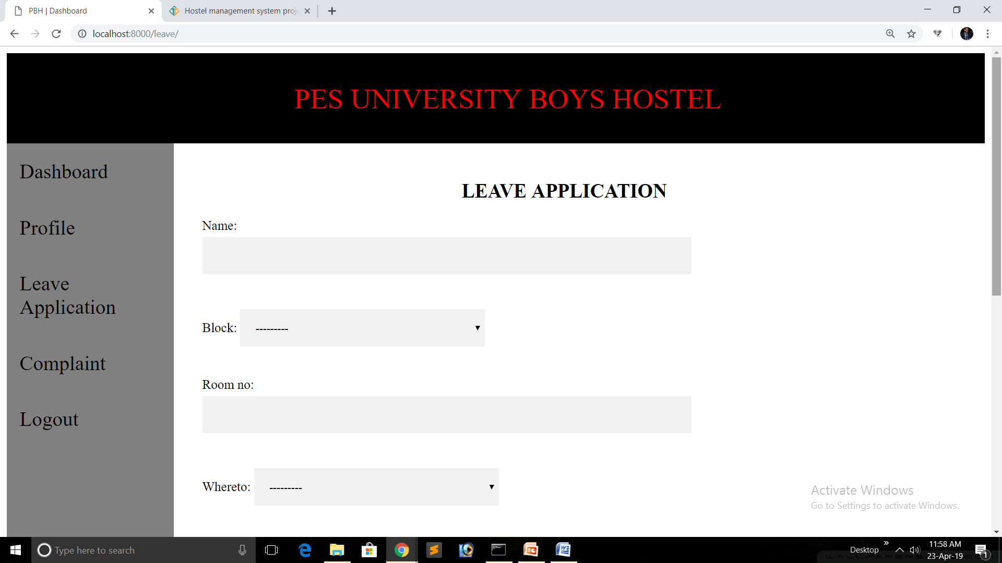

Slide 13
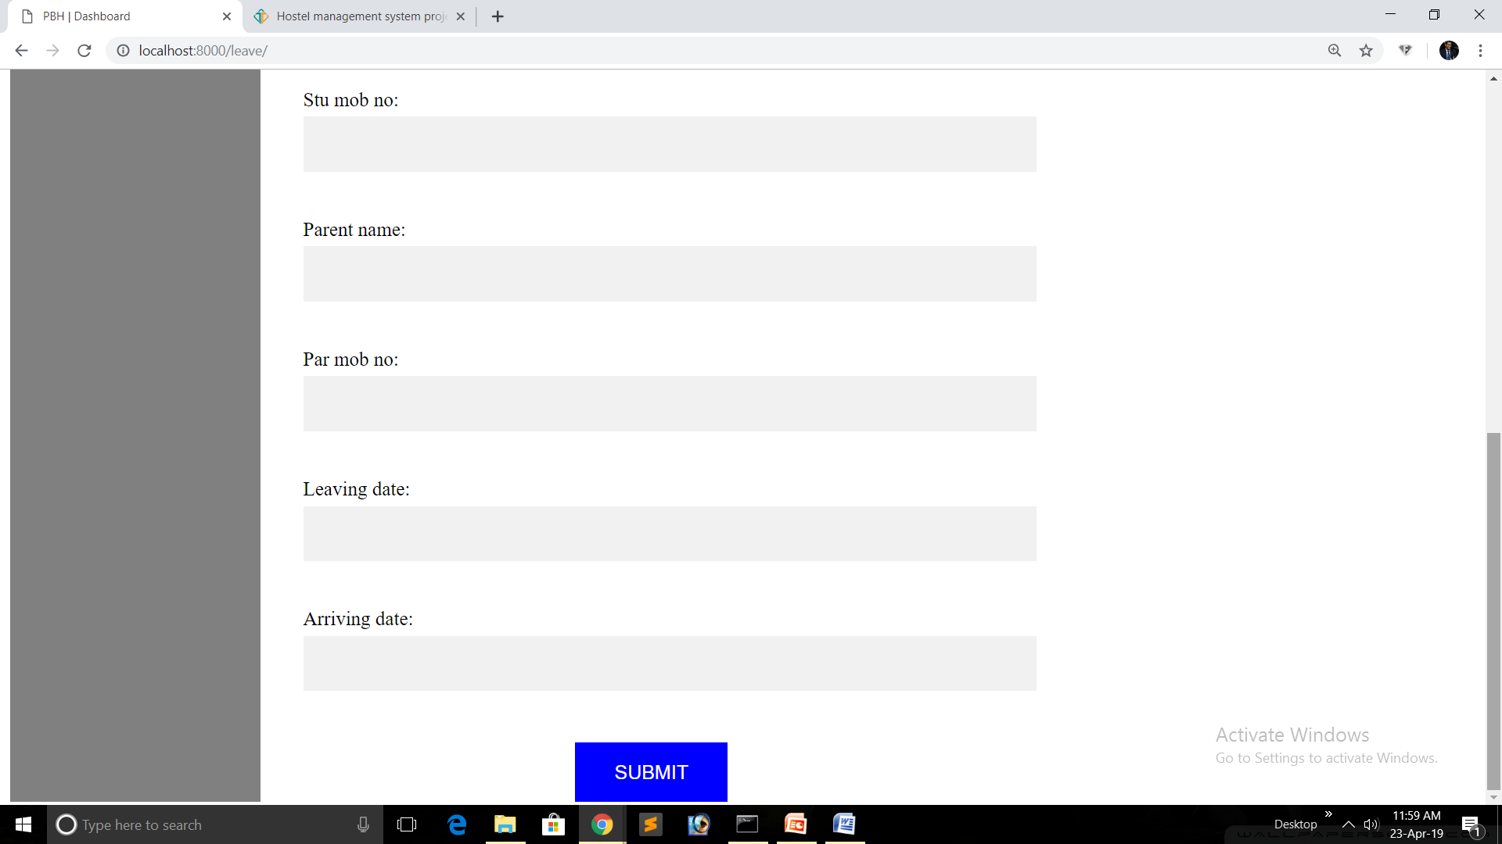

Slide 14
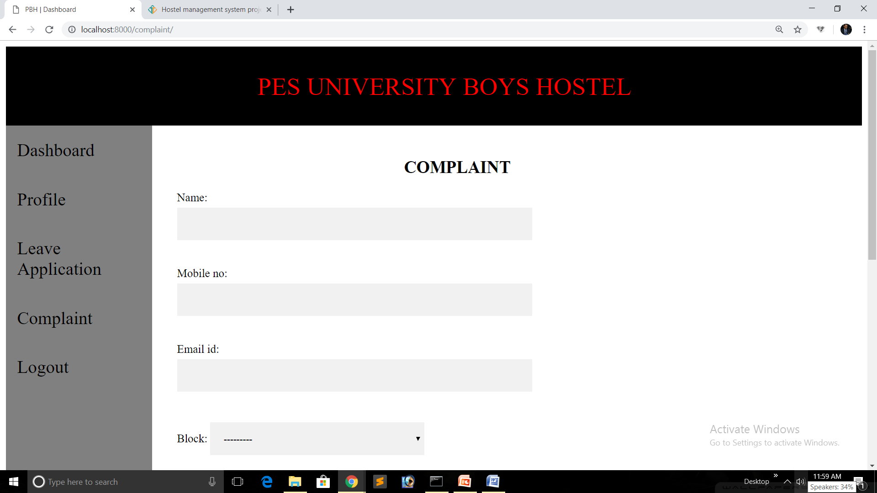

Slide 15
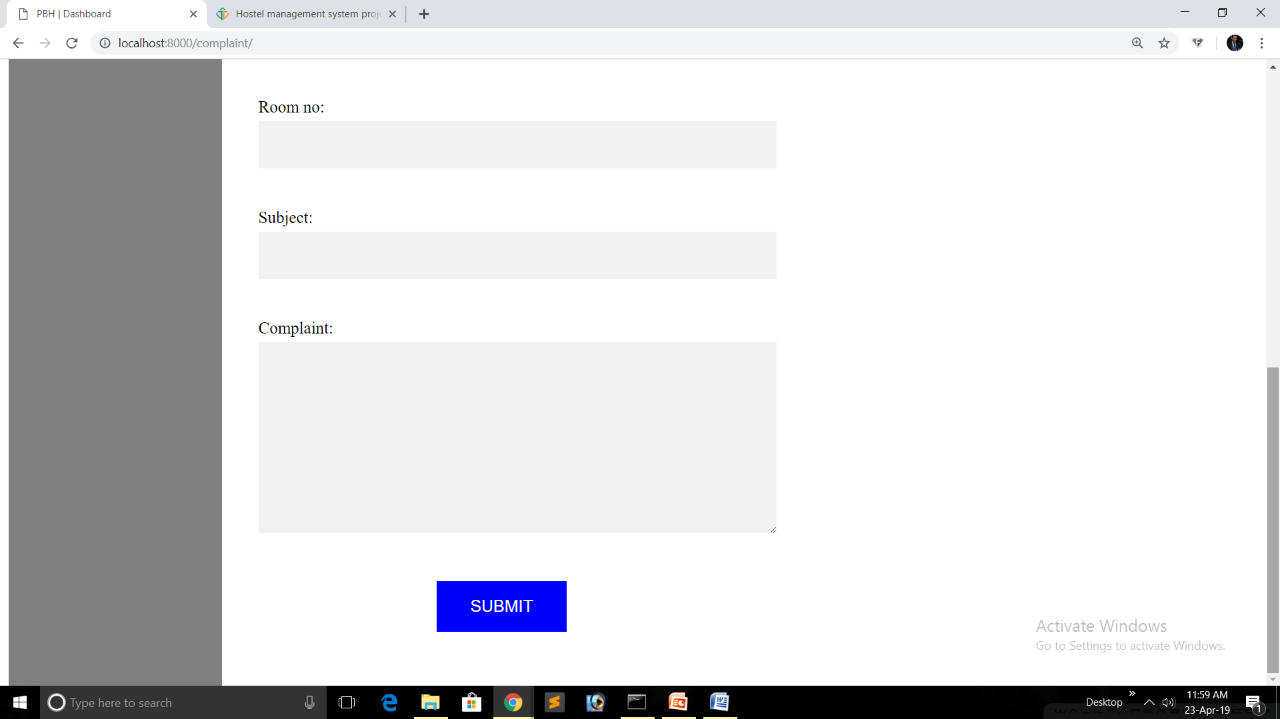

Slide 16
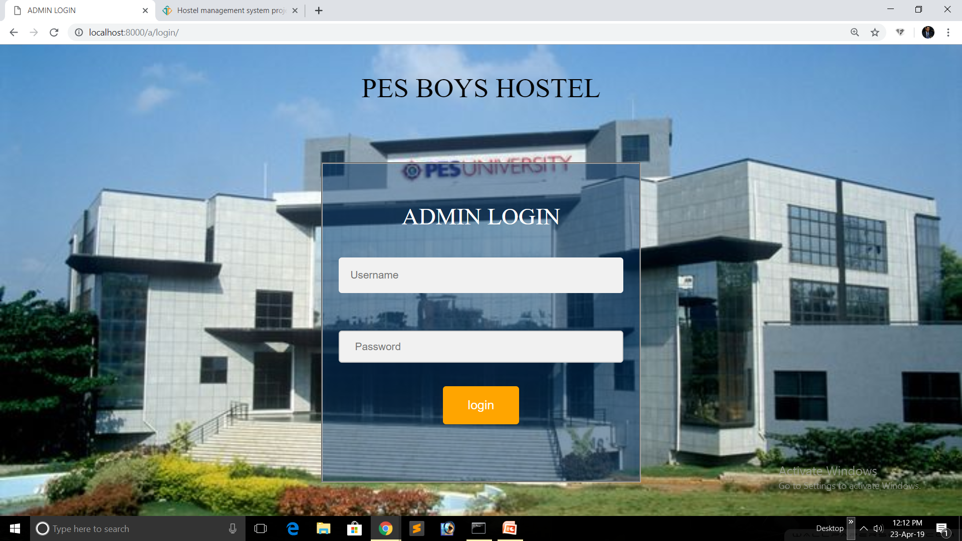

Slide 17
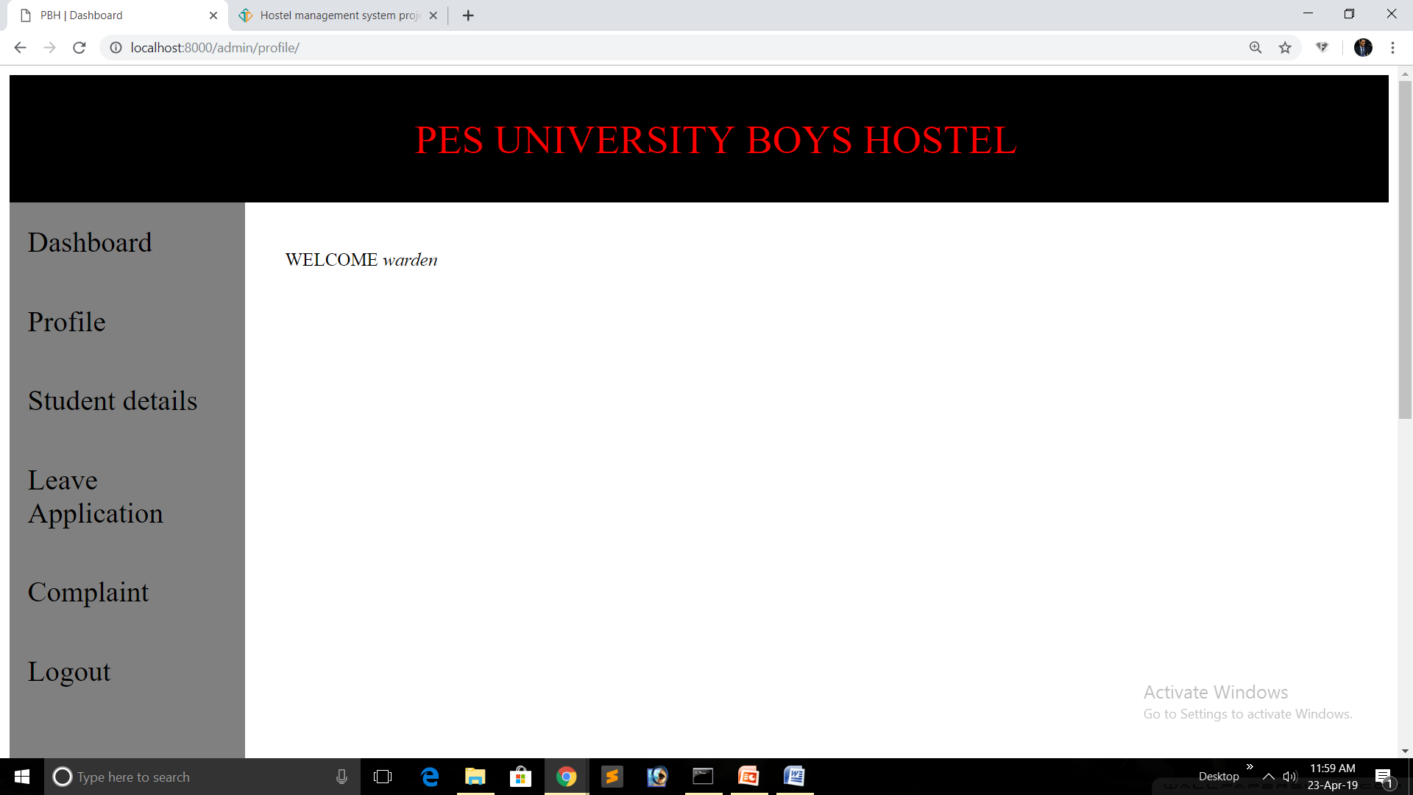

Slide 18
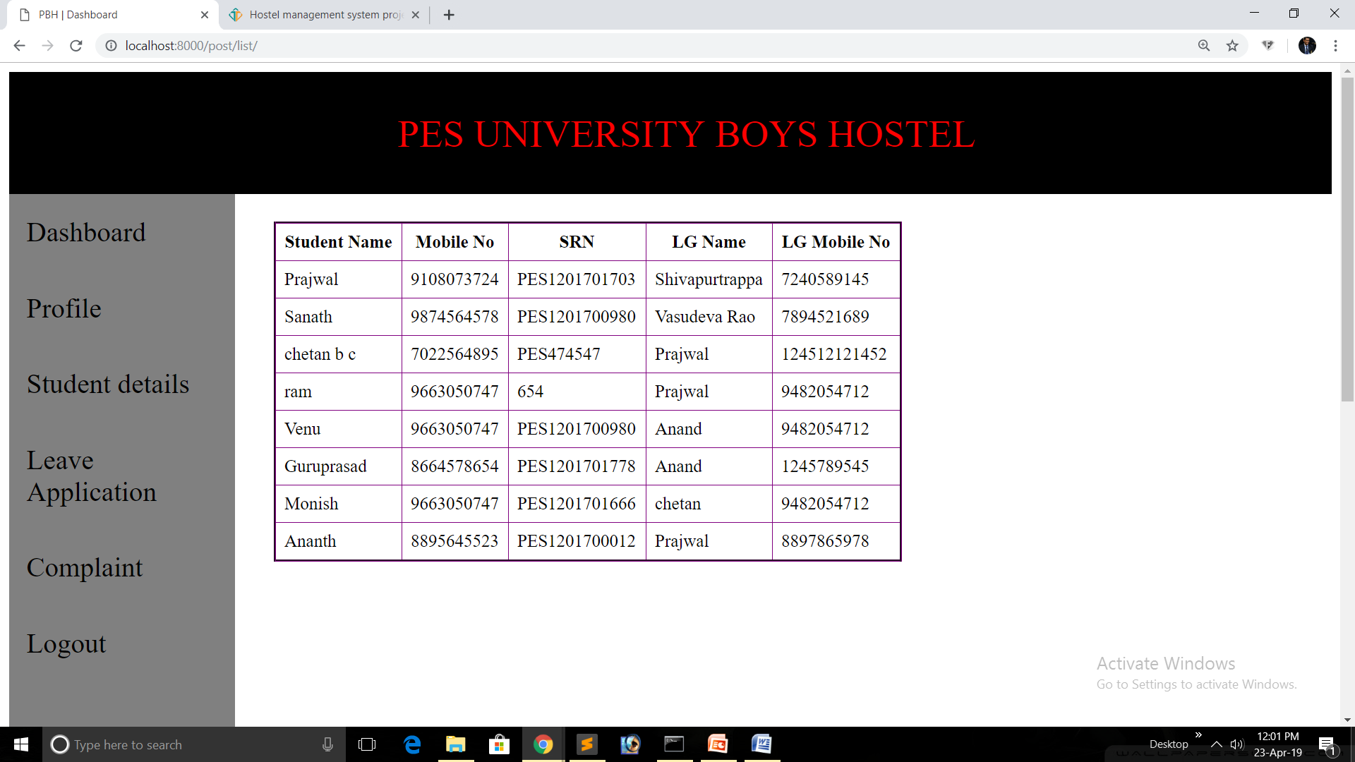

Slide 19
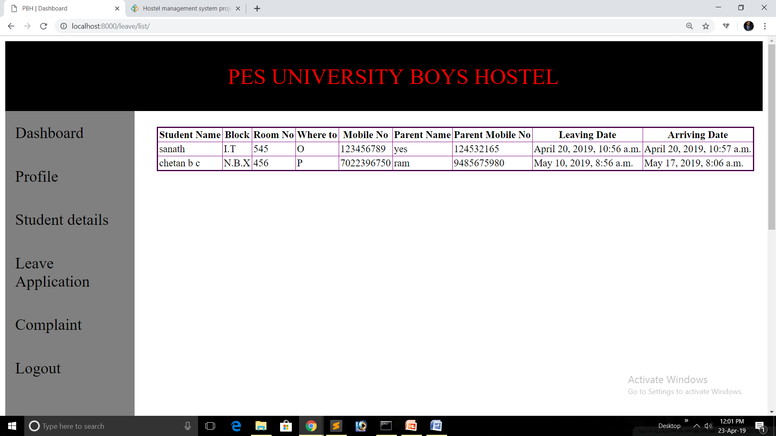

Slide 20
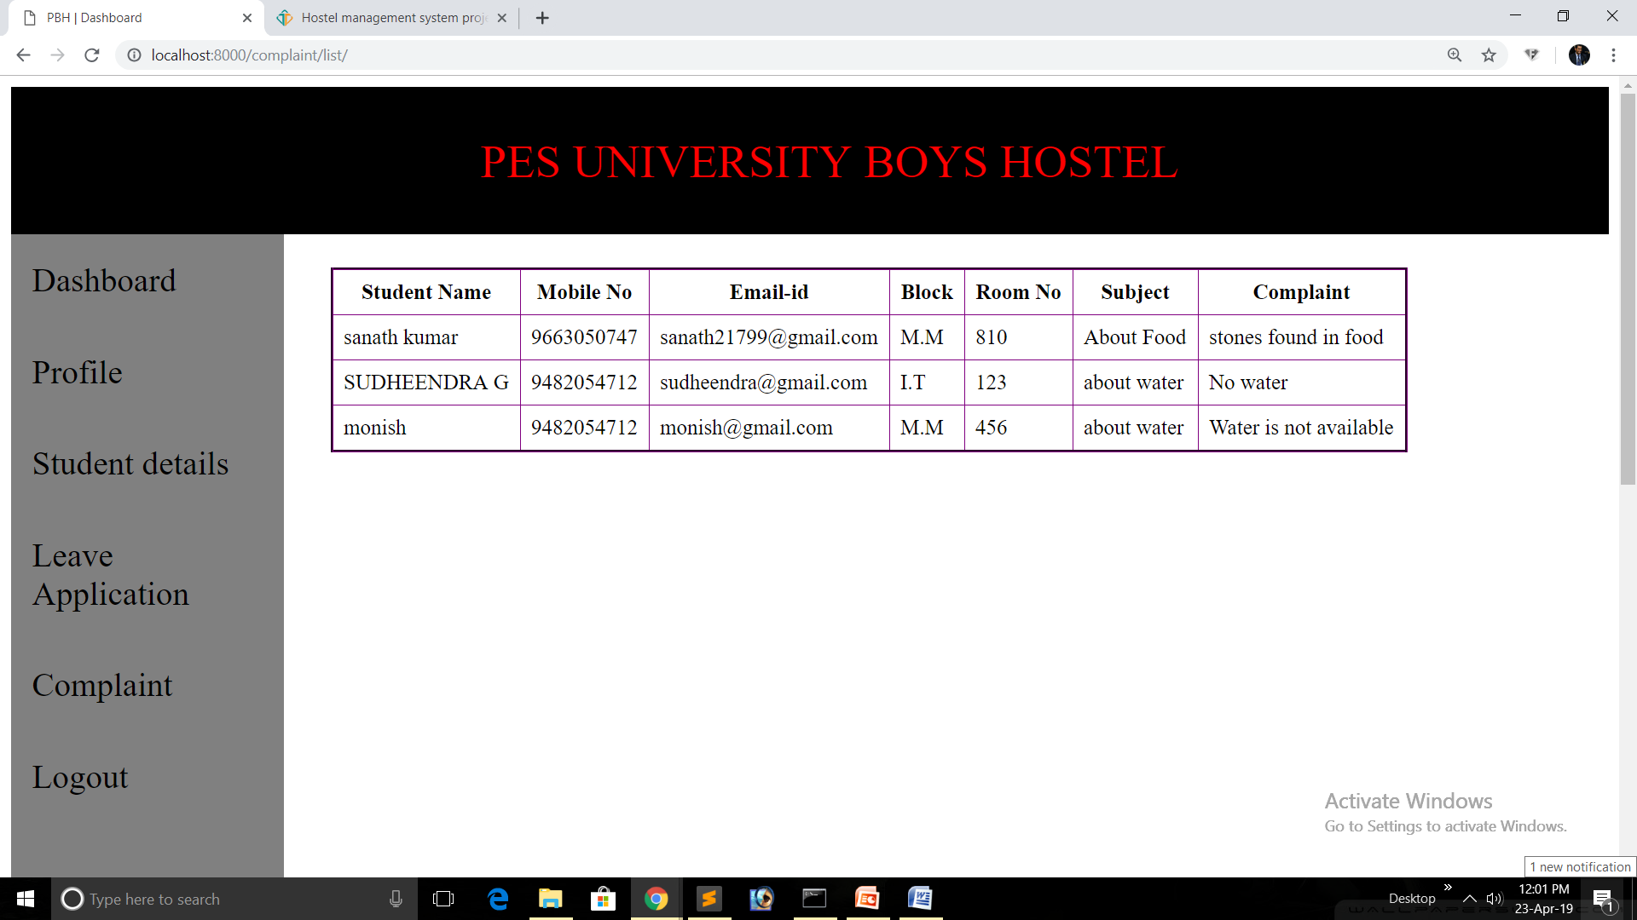

Slide 21
TAKEAWAYS
We got to learn Django in depth and understood it’s concepts well.
We learnt to create a fully functional website and it’s integration with the database in lesser time period.
By the use of base template, we could extend it in other templates, thus reducing repeated code lines, in a faster and easier way.

Slide 22
CHALLENGES
Fetching the data from the database.
Doing the student login validations.
Though we faced few challenges, we were able to overcome it and come up with the best possible solution to all our problems ☺.

Slide 23
CONTACT INFO.
SANATHKUMAR G PES1201701771
sanath21799@gmail.com
CHETAN B CHAVHANNAVAR PES1201701375 cchavannavar@gmail.com
PRAJWAL POTHALKAR PES1201701703 prajwalpothalkar@gmail.com

